Slide 1
Programming Language II CSE-215
Prof. Dr. Mohammad Abu Yousuf
yousuf@juniv.edu

Slide 2
Operators

Slide 3
Introduction
Most of its operators can be divided into the following four groups:
arithmetic,
bitwise,
relational, and
logical.

Slide 4
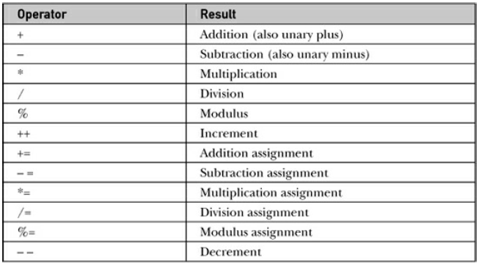
Arithmetic Operators

Slide 5
Arithmetic Operators
The operands of the arithmetic operators must be of a numeric type. You cannot use them on boolean types, but you can use them on char types, since the char type in Java is, essentially, a subset of int.

Slide 6
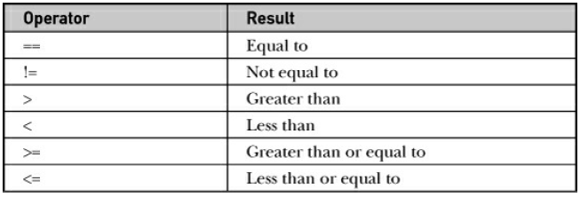
Relational Operators

Slide 7
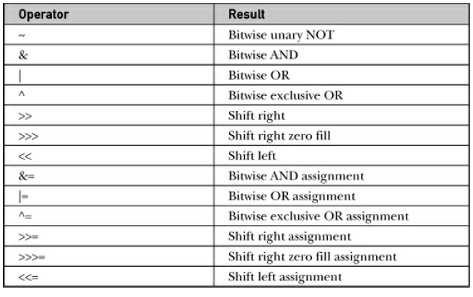
The Bitwise Operators
These operators act upon the individual bits of their operands

Slide 8
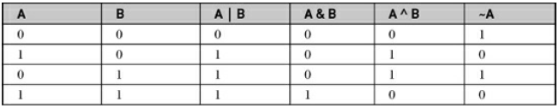
The Bitwise Logical Operators
The bitwise logical operators are &, |, ^, and ~.

Slide 9
Bitwise OR
Bitwise OR is a binary operator (operates on two operands). It's denoted by |.
The | operator compares corresponding bits of two operands. If either of the bits is 1, it gives 1. If not, it gives 0. For example,
12 = 00001100 (In Binary)
25 = 00011001 (In Binary)
Bitwise OR Operation of 12 and 25
00001100
| 00011001
________
00011101 = 29 (In decimal)

Slide 10
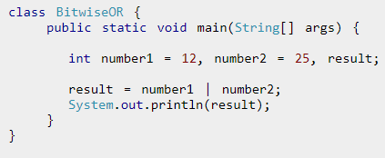

Example 1: Bitwise OR

Slide 11
Bitwise AND
Bitwise AND is a binary operator (operates on two operands). It's denoted by &.
The & operator compares corresponding bits of two operands. If both bits are 1, it gives 1. If either of the bits is not 1, it gives 0.
For example,
12 = 00001100 (In Binary)
25 = 00011001 (In Binary)
Bit Operation of 12 and 25
00001100
& 00011001
________
00001000 = 8 (In decimal)

Slide 12
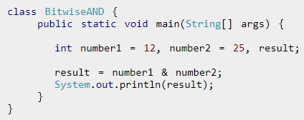

Example 2: Bitwise AND

Slide 13
Bitwise Complement
Bitwise complement is an unary operator (works on only one operand). It is denoted by ~.
The ~ operator inverts the bit pattern. It makes every 0 to 1, and every 1 to 0.
35 = 00100011 (In Binary)
Bitwise complement Operation of 35
~ 00100011
________
11011100 = 220 (In decimal)

Slide 14
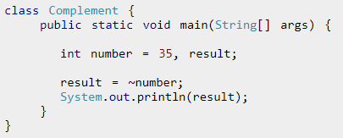

Example 3: Bitwise Complement
Why are we getting output -36 instead of 220?
It's because the compiler is showing 2's complement of that number; negative notation of the binary number.

Slide 15
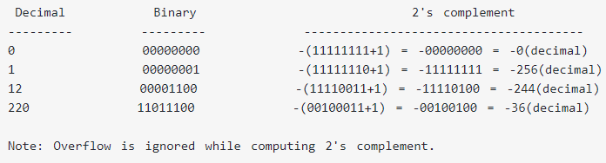
For any integer n, 2's complement of n will be -(n+1).
The bitwise complement of 35 is 220 (in decimal). The 2's complement of 220 is -36. Hence, the output is -36 instead of 220.

Slide 16
Bitwise XOR
Bitwise XOR is a binary operator (operates on two operands). It's denoted by ^.
The ^ operator compares corresponding bits of two operands. If corresponding bits are different, it gives 1. If corresponding bits are same, it gives 0.
For example,
12 = 00001100 (In Binary)
25 = 00011001 (In Binary)
Bitwise XOR Operation of 12 and 25
00001100
| 00011001
________
00010101 = 21 (In decimal)

Slide 17
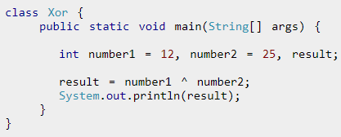

Example 4: Bitwise XOR

Slide 18
left shift, right shift
A= 00111100
<< (left shift)
Binary Left Shift Operator. The left operands value is moved left by the number of bits specified by the right operand
Example: A << 2 will give 240 which is 1111 0000.
>> (right shift)
Binary Right Shift Operator. The left operands value is moved right by the number of bits specified by the right operand.
Example: A >> 2 will give 15 which is 1111

Slide 19
zero fill right shift
>>> (zero fill right shift)Shift right zero fill operator. The left operands value is moved right by the number of bits specified by the right operand and shifted values are filled up with zeros.
Example: A >>>2 will give 15 which is 0000 1111

Slide 20
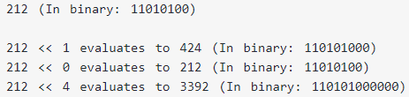
Signed Left Shift
The left shift operator << shifts a bit pattern to the left by certain number of specified bits, and zero bits are shifted into the low-order positions.

Slide 21
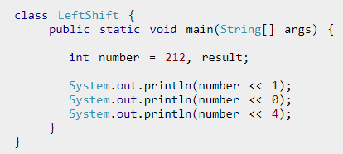
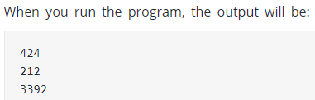
Example: Signed Left Shift

Slide 22
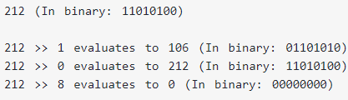
Signed Right Shift
The right shift operator >> shifts a bit pattern to the right by certain number of specified bits.
If the number is a 2's complement signed number, the sign bit is shifted into the high-order positions.

Slide 23
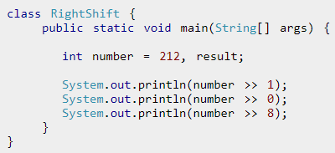
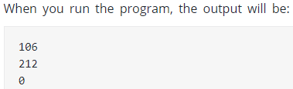
Example: Signed Right Shift

Slide 24
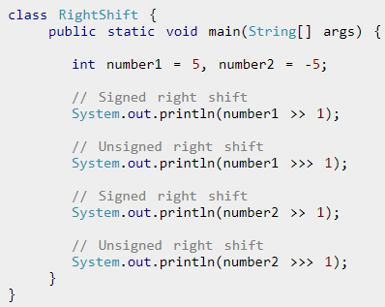
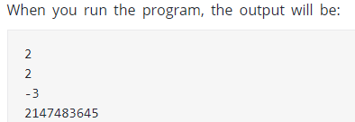
Unsigned Right Shift
The unsigned right shift operator << shifts zero into the leftmost position.
Notice, how signed and unsigned right shift works differently for 2's complement.
The 2's complement of 2147483645 is 3.

Slide 25
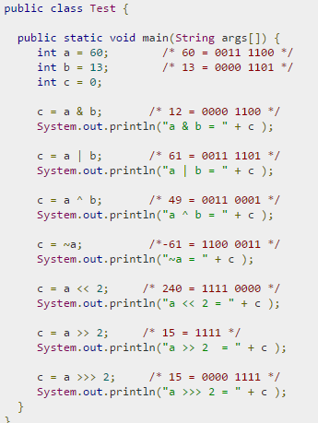


Slide 26
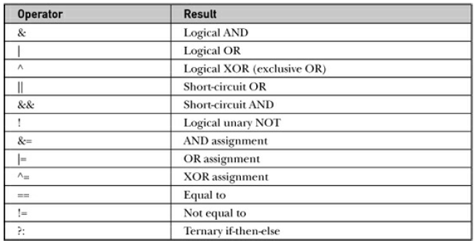
Boolean Logical Operators
The Boolean logical operators shown here operate only on boolean operands. All of the binary logical operators combine two boolean values to form a resultant boolean value.

Slide 27
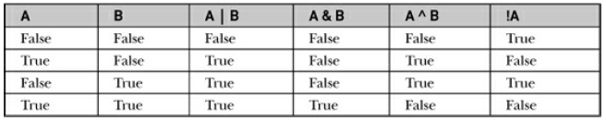
Boolean Logical Operators
The logical Boolean operators, &, |, and ^, operate on boolean values in the same way that they operate on the bits of an integer.

Slide 28
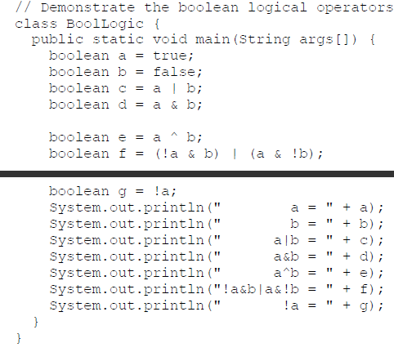
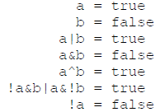
Boolean Logical Operators
the string representation of a Java boolean value is one of the literal values true or false

Slide 29
Java AND Operator Example: Logical && and Bitwise &
The logical && operator doesn't check second condition if first condition is false. It checks second condition only if first one is true.
The bitwise & operator always checks both conditions whether first condition is true or false.
class OperatorExample{
public static void main(String args[]){
int a=10;
int b=5;
int c=20;
System.out.println(a<b&&a++<c);//false && true = false
System.out.println(a);//10 because second condition is not checked
System.out.println(a<b&a++<c);//false && true = false
System.out.println(a);//11 because second condition is checked
}}
Output:
false
10
false
11

Slide 30
Java AND Operator Example: Logical && and Bitwise &
This is very useful when the right-hand operand depends on the value of the left one in order to function properly.
For example, the following code fragment shows how you can take advantage of short-circuit logical evaluation to be sure that a division operation will be valid before evaluating it:
Since the short-circuit form of AND (&&) is used, there is no risk of causing a run-time exception when denom is zero. If this line of code were written using the single & version of AND, both sides would be evaluated, causing a run-time exception when denom is zero.

Slide 31
Java OR Operator Example: Logical || and Bitwise |
The logical || operator doesn't check second condition if first condition is true. It checks second condition only if first one is false.
The bitwise | operator always checks both conditions whether first condition is true or false.
class OperatorExample{
public static void main(String args[]){
int a=10;
int b=5;
int c=20;
System.out.println(a>b||a<c);//true || true = true
System.out.println(a>b|a<c);//true | true = true
//|| vs |
System.out.println(a>b||a++<c);//true || true = true
System.out.println(a);//10 because second condition is not checked
System.out.println(a>b|a++<c);//true | true = true
System.out.println(a);//11 because second condition is checked
}}

Slide 32
Java OR Operator Example: Logical || and Bitwise |
Output: Previous program
true
true
true
10
true
11

Slide 33
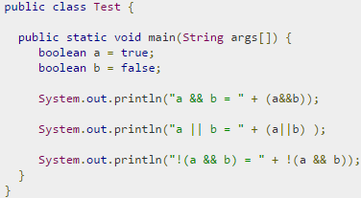


Slide 34
Conditional Operator ( ? : )
Conditional operator is also known as the ternary operator. This operator consists of three operands and is used to evaluate Boolean expressions. The goal of the operator is to decide which value should be assigned to the variable. The operator is written as:

Slide 35
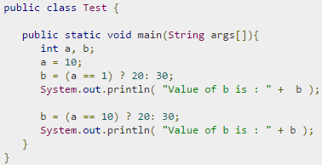

Conditional Operator ( ? : )

Slide 36
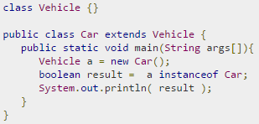
instance of Operator
This operator is used only for object reference variables. The operator checks whether the object is of a particular type (class type or interface type). instanceof operator is written as:
Output

Slide 37
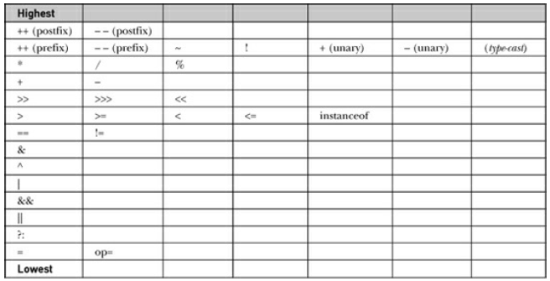
Operator Precedence

Slide 38
Thank you

